Slide 1
4th/5th Intermediate Group Expectations

Slide 2
Being Prepared for Learning
You should travel to every class with the following:
Folder containing all class materials and unfinished work
Supply pouch/box
Agenda
Personal reading material - Novels not picture books

Slide 3
Transitions
Walk quietly in the halls, and wait silently for invitation into the classroom
Enter the room quietly and with purpose
Be prepared to get RIGHT to work
Follow teacher instructions and normal classroom procedures
When preparing to leave, gather all materials and clean up your area

Slide 4
Homework and Due Dates
All due dates are solid
Late work is accepted but will be recorded as late and will affect Habits of Success grades

Slide 5
Expectations During Instruction
Focused on the teacher and the lesson being taught
Raise your hand
Side conversations, reading a book, or doodling is not for this time

Slide 6
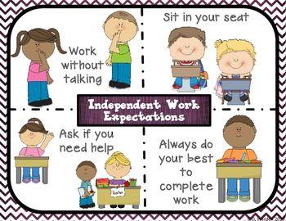
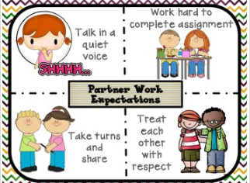
Expectations During Independent, Group Work, and Free Time
Keep in mind: Free time is NOT a time to be out of control, making messes, destroying property, and being obnoxious. If you cannot handle yourself, you will not be invited to enjoy free time and an alternate plan will be made for you! Leave your area BETTER than you found it!

Slide 7
Quality Work Expectations
First and last name and number on all papers.
Neatness counts - Numbers and letters on the line numbers and letters same size, and formed properly.
No doodling, holes, or tears as much as can be helped
Full effort is made to protect papers.
Most importantly, full effort is given when completing papers. A poorly completed paper wastes both our time.

Slide 8
Redo Work
Own your learning! If you get a poor grade on a paper, review the mistakes and make thoughtful changes and resubmit.
A failing paper received and returned before Thursdays will count as missing work for Free Time. A red X will represent such papers on the shared spreadsheet.
Redo papers in a timely manner.

Slide 9
Consequences
Positive:
Grades
Low stress
Free time
Negative:
Loss of free time
Increased stress

Slide 10
Habits of Success
RESPONSIBILITY
-Worked to the best of my ability
-Completed tasks independently
-Turned in work on time
EMPATHY
-Respects others & their property
-Values the class & school
-Shows respect for others’ opinions
SELF-MANAGE THEIR LEARNING
-Initiates and manages personal learning
-Self advocacy (stand up for myself)
-Organized
COOPERATION
-Active group member
-Displays a positive attitude
-Growth mindset
FOLLOW ARRRGH EXPECTATIONS
-Respect Yourself
ARRRGH!!

